Slide 1

Applied Software Project Management
Project Schedules

Slide 2
What is a project schedule?
The project schedule is a calendar that links the tasks to be done with the resources that will do them.
  Before a project schedule can be created, the project manager must have a work breakdown structure (WBS) and estimates.
  The schedule is part of the project plan.

Slide 3
Scheduling concepts:
Effort vs. Duration
Effort represents the work required to perform a task.
  Effort is measured in person-hours (or person-days, person-weeks, etc.)
  It represents the total number of hours that each person spent working on the task.
Duration is amount of time that elapses between the time the task is started and the time it is completed.
  Duration is measured in hours (or days, weeks, etc.)
  It does not take into account the number of people performing the task

Slide 4
Scheduling concepts:
Slack and Overhead
Slack is the amount of time which any of the tasks can be delayed without causing the due date of the final task in the sequence to be delayed as well.
  A tight schedule has very little slack; a delay in any task will cause a delay in the due date
  Parkinson’s Law: “Work expands so as to fill the time available for its completion.”
Overhead is any effort that does not go to the core activities of the task but is still required in order for the people to perform it—a sort of “real world” cost of actually doing the work.
  Two people performing a task will require more effort than one person doing the same task
  Assigning two people to the task requires more effort, but the task has a shorter duration

Slide 5
Building the project schedule
Allocate resources
  For each task in the WBS, one or more resources must be assigned
  Choose person or people for each task based on qualifications, familiarity and availability
  Take overhead into account when calculating the duration of each task

Slide 6
Building the project schedule
Identify dependencies
  A task has a dependency if it involves an activity, resource or work product which is subsequently required by another task
  Tasks may have dependencies because they require the same resource

Slide 7
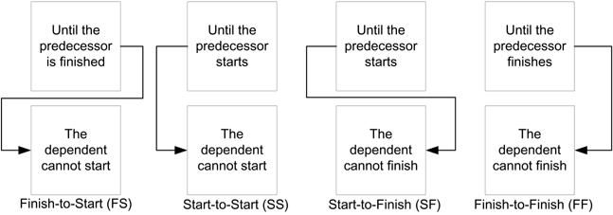
Building the project schedule
Identify dependencies (continued)
  Every dependency has a predecessor, or a task that must be begun, in progress, or completed, for another task to begin
  Identify the type of predecessor for each dependency

Slide 8
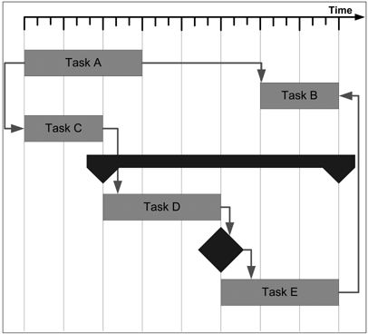
Building the project schedule
Create the schedule
  Most project schedules are represented using a Gantt chart
  The Gantt chart shows tasks, dependencies and milestones using different shapes

Slide 9
Building the project schedule
Reconcile the schedule with the organization’s needs
  Once resources are allocated to each task, a final date can be calculated
  If this date is unacceptable, the project plan must change
  Either additional resources must be allocated to the project or the scope must be cut down
  Brooks’ Law: “Nine women cannot have a baby in one month.”
    In other words, some tasks can only be done by one person, no matter how critical they are.

Slide 10
Building the project schedule
Add review meetings to the schedule
  Progress reviews are meetings held regularly to check the progress of a project versus it's scheduled progress.
  Milestone reviews are meetings which the project manager schedules in advance to coincide with project events.
    The most common way for project managers to handle milestone reviews is to schedule them to occur after the last task in a project phase (such as the end of design or programming).

Slide 11
Building the project schedule
Step 4: Optimize the schedule
  The critical path is the sequence of tasks that represent the minimum time required to complete the project.
    If a task is only on the critical path when delaying that task will delay the project.
    Allocating resources to tasks on the critical path will reduce the project schedule; allocating them to other tasks will have less effect.
  A resource is over-allocated if more than 100% allocated to multiple tasks simultaneously
    If any resource is over-allocated, it means that there is a dependency between two tasks which was not discovered.
    When this happens, the schedule is guaranteed to be inaccurate. Find and fix over-allocated resources.

Slide 12
Don’t abuse buffers
A buffer is a task added to the schedule with no specific purpose except to account for unexpected delays.
  This practice involves either adding extra tasks or padding existing tasks at strategic points in the schedule where overruns are “expected”.
  Buffers can be useful:
    On a year-long project, every programmer will take two weeks of vacation
    Buffers can be used to account for this known delay
  Buffers are often abused
    The idea that overruns are expected means that there is an implicit assumption that the estimate is incorrect.
    Buffers should not be used to add time to compensate for an inaccurate estimate.

Slide 13
Project metrics
The baseline is the version of the schedule that has been approved
  The schedule will change based on the actual work done by the project team.
  When the deadline of the revised schedule is later than that of the baseline, the project has slipped.
Variance is the difference between the estimated effort in the baseline and the actual effort performed by the team.

Slide 14
Project metrics
Earned value management tracks the project by considering effort “earned” against a budget only after it has actually been performed
  The budgeted cost for work scheduled (BCWS) is the estimated effort of the actual tasks that appear on the schedule to date.
  The actual cost of work performed (ACWP) is the effort spent on the tasks in the schedule that have actually been completed by the development team members.
  Variance = BCWS – ACWP

Slide 15
Project metrics
The cost performance index is used to compare projects with each other or to compare phases within a project
  CPI is calculated by dividing BCWS / ACWP (budgeted cost for work scheduled/actual cost for work performed) and multiplying by 100 to express it as a percentage.
  A CPI of 100% means that the estimated cost was exactly right and the project came in exactly on budget.
  A CPI under 100%, the work cost less effort than planned; a CPI greater than 100% means that the estimate was not adequate for the work involved.
    For example, if the programming tasks took twice as long as estimated but every other type of task in the project took less time than estimated, the total variance for the project might still be low. However, the problem can still be pinpointed by calculating the CPI for each phase of development.

